Slide 1
Radiation II
Dr. Afnan Hasan
Assistant Professor
Department of Mechanical Engineering
Chittagong University of Engineering and Technology

Slide 2
THE VIEW FACTOR
Radiative heat transfer between surfaces depends on their temperatures, material characteristics, and how they are positioned relative to each other.
Sitting near a fire 🔥: You feel much warmer when you face the fire directly than when you turn sideways or sit behind someone, because more radiation reaches you when you’re directly exposed.
Solar panels 🌞: Panels are tilted to face the sun directly to maximize the amount of radiation they absorb; if they are misaligned, their efficiency drops.
Heater in a room 🔥: You feel warmer sitting directly in front of a heater than sitting off to the side, because the radiation is strongest along the direct line of sight.

Slide 3
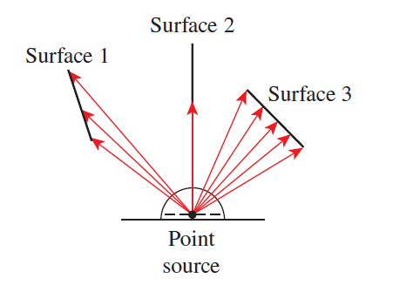
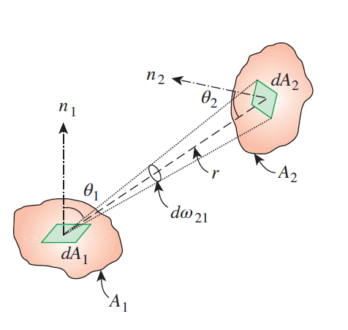
THE VIEW FACTOR
To include the effect of how surfaces are positioned relative to each other in radiation heat transfer, a parameter called the view factor is introduced. This factor depends only on geometry and does not depend on the materials or temperatures of the surfaces. It is also known as the shape factor, configuration factor, or angle factor.
The view factor from a surface i to a surface j is denoted by
F _{i → j} or just F _{ij} , and is defined as
F _{ij} = the fraction of the radiation leaving surface i that strikes surface j directly

Slide 4
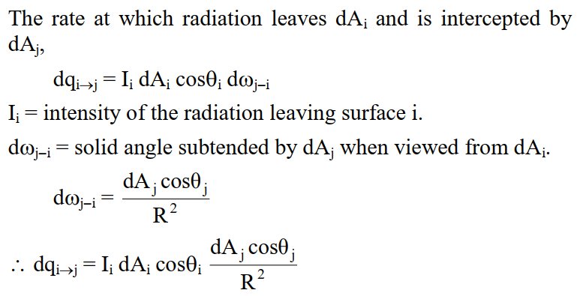
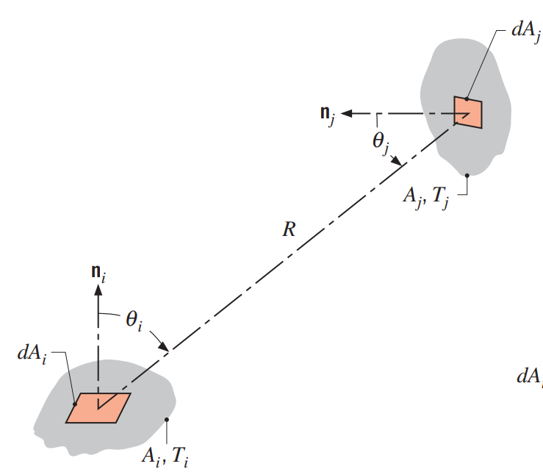
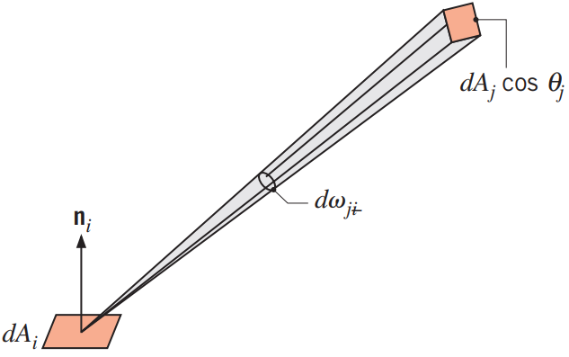

THE VIEW FACTOR
The view factor/ shape factor (F_{ij}) is defined as the fraction of the radiation leaving surface i that is intercepted by surface j.
A_{i}, A_{j} = Arbitrarily oriented surfaces
dA_{i}, dA_{j} = Elemental areas on A_{i} and A_{j} respectively.
R = length of line connecting dA_{i} and dA_{j}.
The connected line forms the polar angles θ_{i} and θ_{j} with the surface normals n_{i} and n_{j} respectively. The values of R, θ_{i} and θ_{j} vary with the position of the elemental areas on A_{i} and A_{j}.

Slide 5
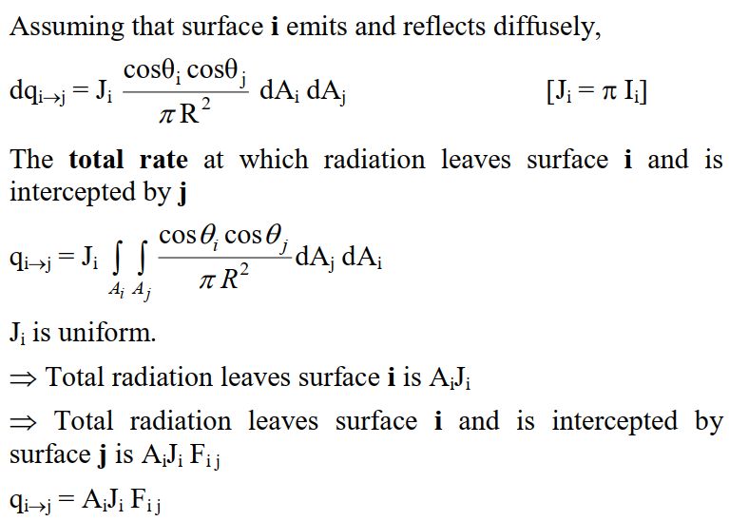
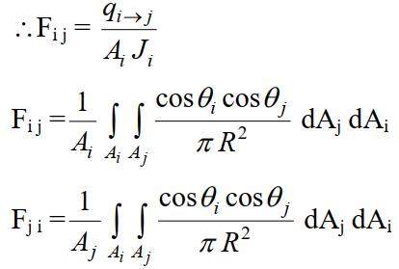
THE VIEW FACTOR
These relations confirm that the view factor between two surfaces depends on their relative orientation and the distance between them.

Slide 6
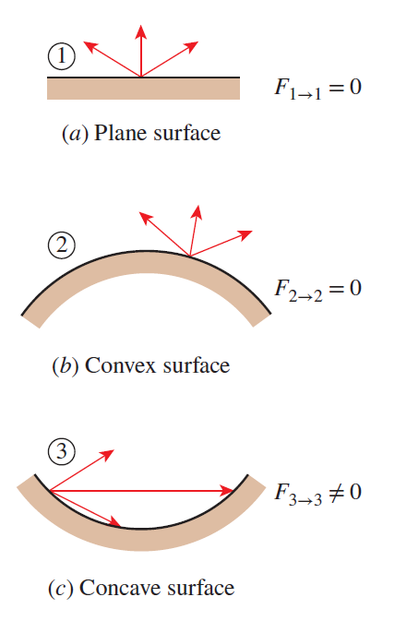
THE VIEW FACTOR
In the absence of strong electromagnetic fields radiation beams travel in straight paths, the view factor from a surface to itself is zero unless the surface “sees” itself. Therefore, F_{i → i} = 0 for plane or convex surfaces and F_{i → i} ≠ 0 for concave surfaces
The value of the view factor ranges between zero and one. The limiting case F_{i → i} = 0 indicates that the two surfaces do not have a direct view of each other, and thus radiation leaving surface i cannot strike surface j directly. The other limiting case F_{i → j} = 1 indicates that surface j completely surrounds surface i, so all radiation leaving surface i is intercepted by surface j. For example, in a geometry consisting of two concentric spheres, all radiation leaving the surface of the smaller sphere (surface 1) strikes the larger sphere (surface 2), and thus F_{1 → 2} = 1

Slide 7
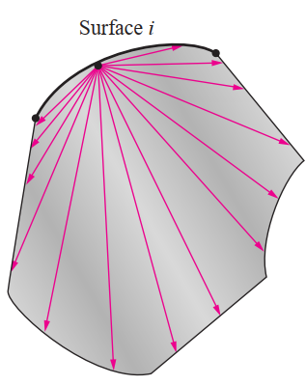
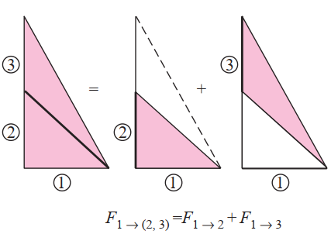
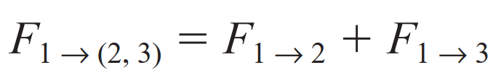


View factor relations
1. Reciprocity relation
A_{i} F_{i} _{j} = A_{j} F_{j} _{i}
This relation is referred to as the reciprocity relation or the reciprocity rule, and it enables us to determine the counterpart of a view factor from a knowledge of the view factor itself and the areas of the two surfaces.
2. Summation rule
The conservation of energy principle requires that the entire radiation leaving any surface i of an enclosure be intercepted by the surfaces of the enclosure. Therefore, the sum of the view factors from surface i of an enclosure to all surfaces of the enclosure, including to itself, must equal unity. This is known as the summation rule for an enclosure.
N
∑ Fi j = 1 (Enclosure with N surfaces)
j =1
3. The Superposition Rule
The view factor from a surface i to a surface j is equal to the sum of the view factors from surface i to the parts of surface j.

Slide 8
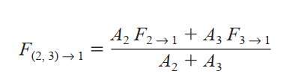
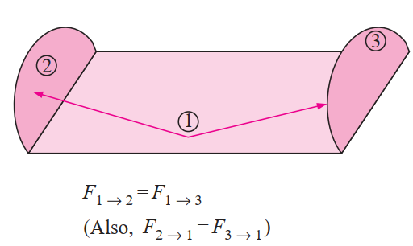
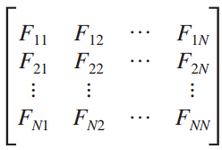
4. The Symmetry Rule
The symmetry rule can be expressed as two (or more) surfaces that possess symmetry about a third surface will have identical view factors from that surface.
To calculate radiation exchange in an enclosure of N surfaces, a total of N² view factors is needed. This requirement becomes evident when the view factors are arranged in the matrix form:
However, all the view factors need not be calculated directly.
A total of N view factors may be obtained from the N equations associated with application of the summation rule to each of the surfaces in the enclosure.
In addition, N(N – 1)/2 view factors may be obtained from the N(N – 1)/2 applications of the reciprocity relation which are possible for the enclosure.
Accordingly, only [N² – N – N (N – 1)/2] = N(N – 1)/2 view factors need be determined directly.

Slide 9
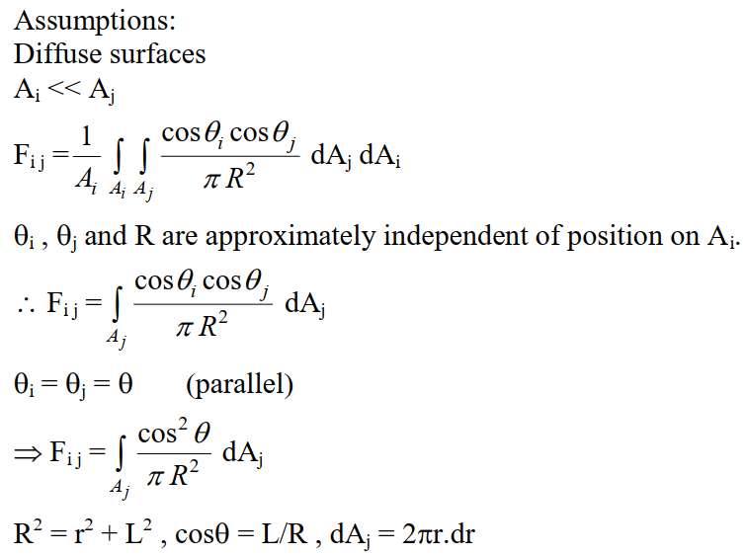
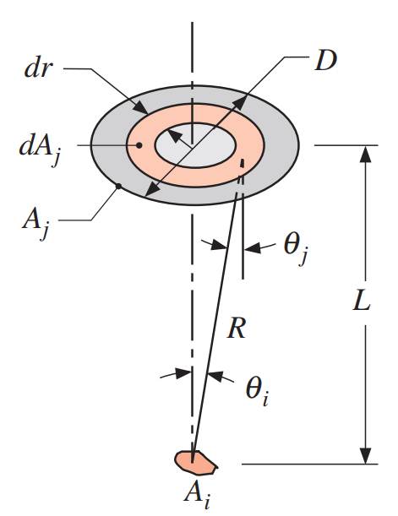
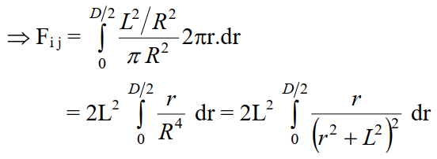
Consider a diffuse circular disk of diameter D and area A_{j} and a plane diffuse surface of area A_{i} << A_{j}. The surfaces are parallel, and A_{i} is located at a distance L from the center of A_{j}. Obtain an expression for the view factor F_{ij}.
r

Slide 10
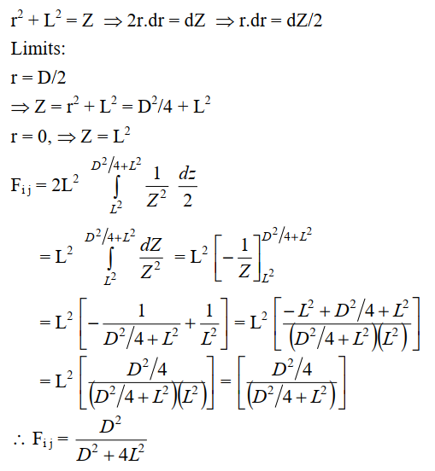
r

Slide 11
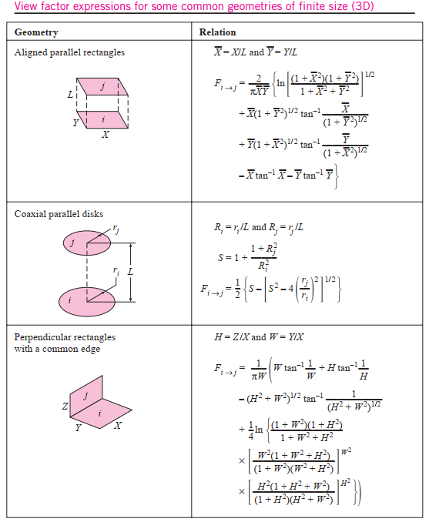

Slide 12
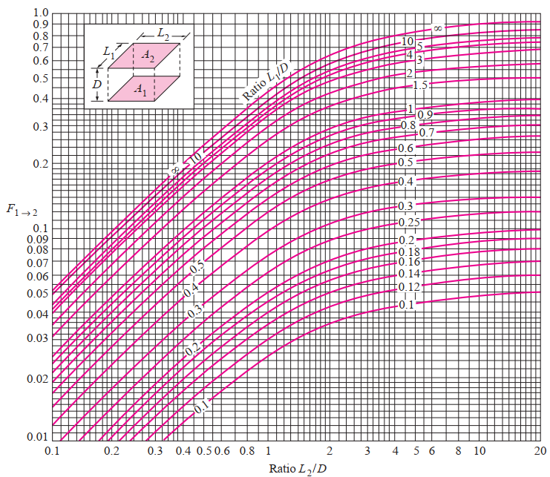
View factor between two aligned parallel rectangles of equal size.

Slide 13
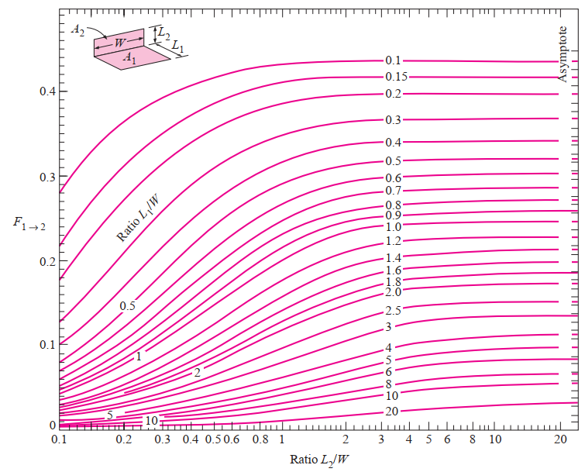
View factor between two perpendicular rectangles with a common edge.

Slide 14
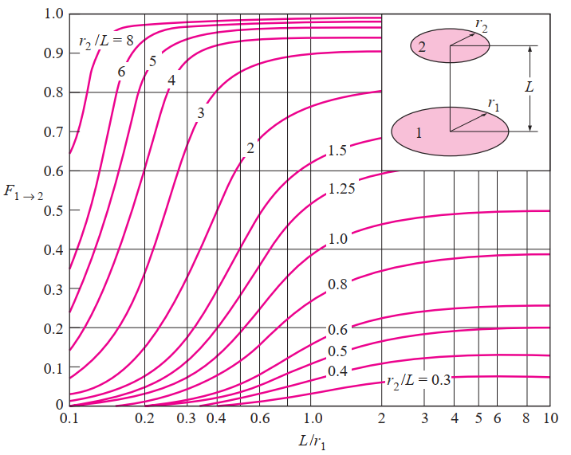
View factor between two coaxial parallel disks.

Slide 15
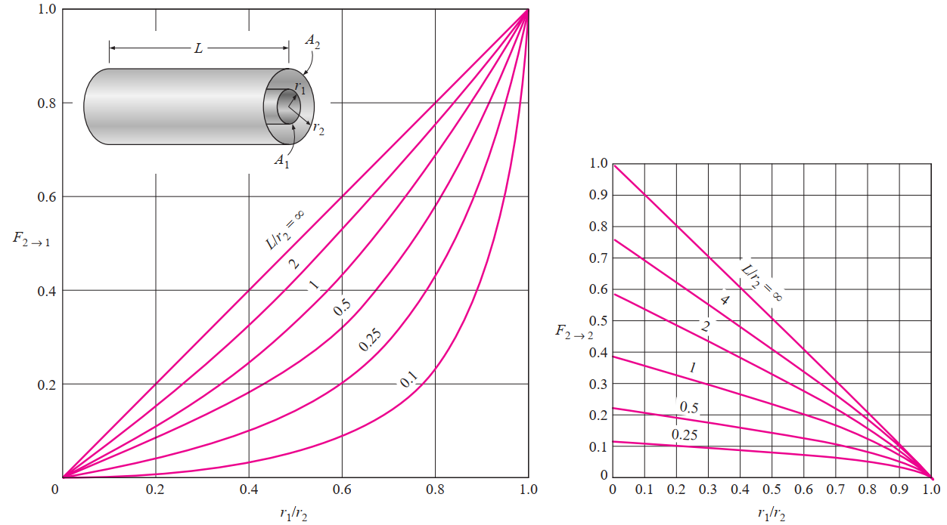
View factors for two concentric cylinders of finite length: (a) outer cylinder to inner cylinder; (b) outer cylinder to itself

Slide 16

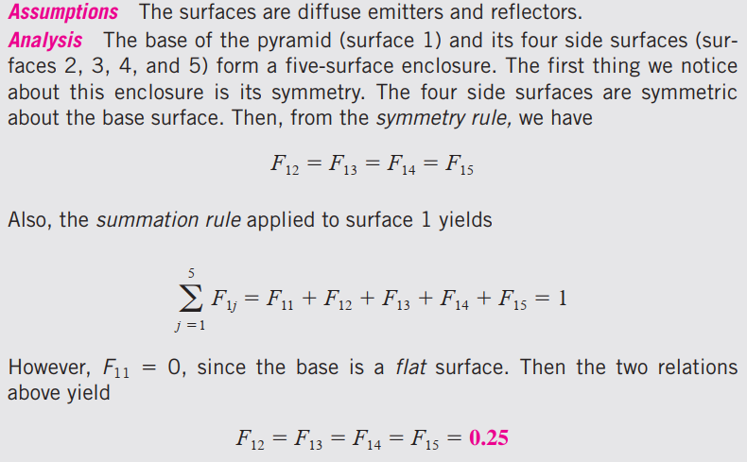
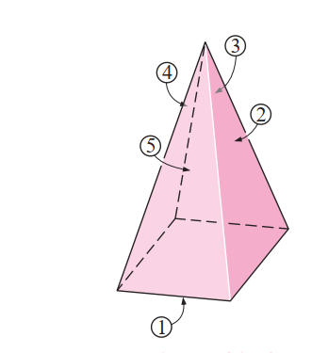

Slide 17

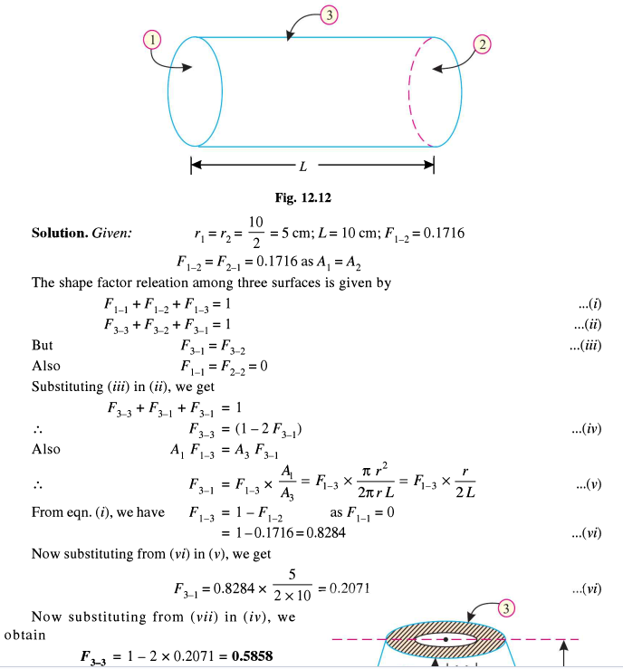

Slide 18
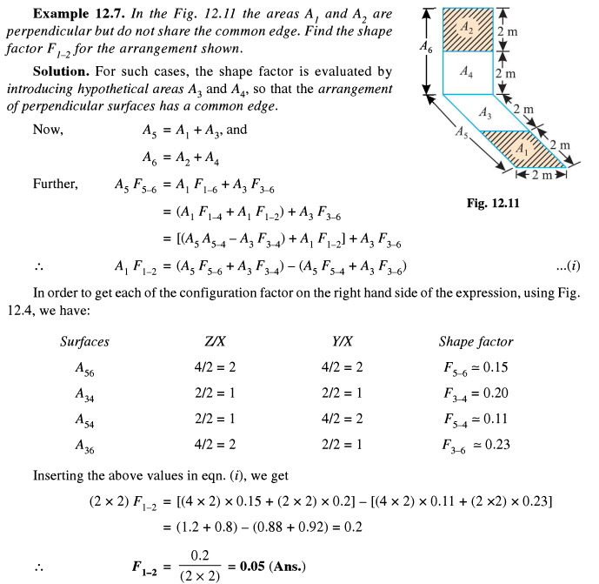

Slide 19
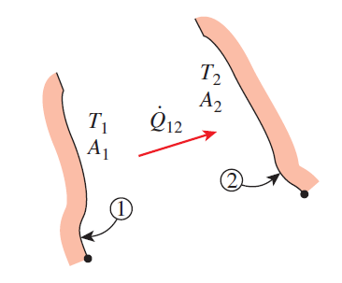
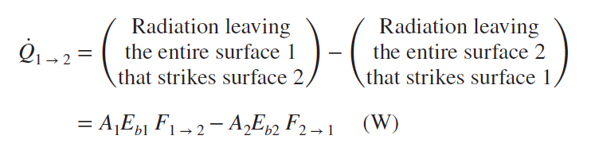
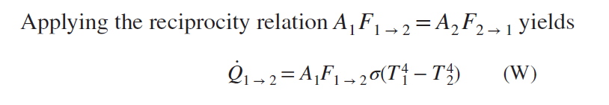

RADIATION HEAT TRANSFER: BLACK SURFACES
Now consider an enclosure consisting of N black surfaces maintained at specified temperatures. The net radiation heat transfer from any surface i of this enclosure is determined by adding up the net radiation heat transfers from
surface i to each of the surfaces of the enclosure:

Slide 20
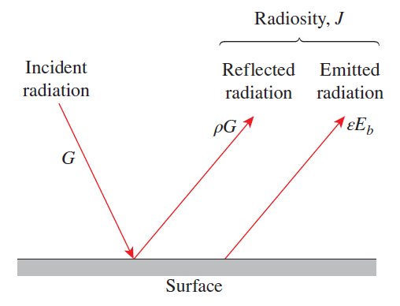
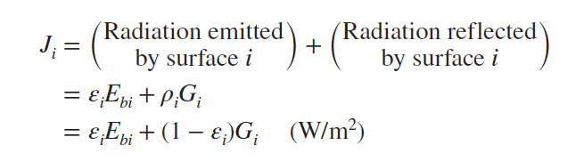

RADIATION HEAT TRANSFER: DIFFUSE, GRAY SURFACES
Surfaces emit radiation as well as reflect it, and thus the total radiation leaving a surface consists of emitted and reflected parts. The total radiation energy leaving a surface per unit time and per unit area is the radiosity and is denoted by J .
For a surface i that is gray and opaque, the radiosity can be expressed as
For a surface that can be approximated as a blackbody, the radiosity relation reduces to
That is, the radiosity of a blackbody is equal to its emissive power. This is expected, since a blackbody does not reflect any radiation, and thus radiation coming from a blackbody is due to emission only.

Slide 21
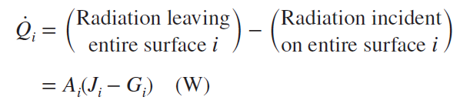
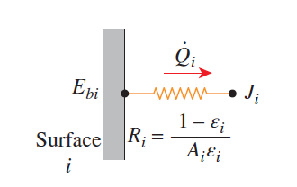
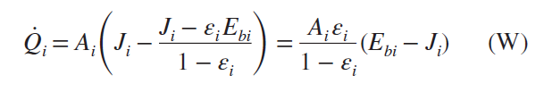
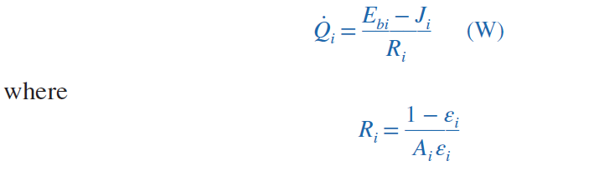
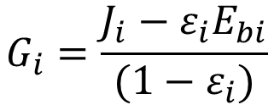

Net Radiation Heat Transfer to or from a Surface
During a radiation interaction, a surface loses energy by emitting radiation and gains energy by absorbing radiation emitted by other surfaces. A surface experiences a net gain or a net loss of energy, depending on which quantity is larger. The net rate of radiation heat transfer from a surface i of surface area A_{i} is denoted by Q_{i} and is expressed as
Solving for G i
$$J_{i}=ε_{i}E_{bi}+(1−ε_{i})G_{i}$$
In an electrical analogy to Ohm’s law, this equation can be rearranged as
$$G_{i}=\frac{J_{i}−ε_{i}E_{bi}}{(1−ε_{i})}$$
surface resistance

Slide 22
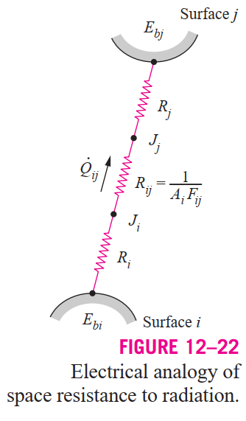
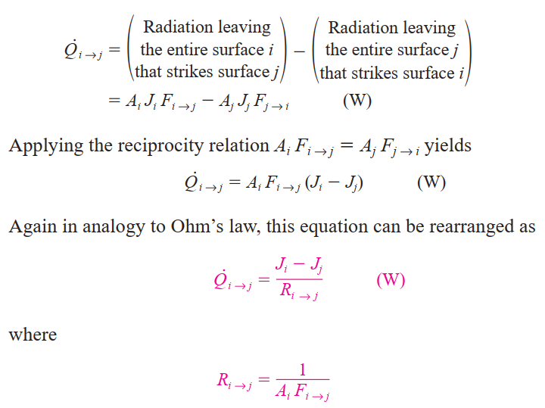
Radiation exchange between two surfaces
Space or geometrical resistance

Slide 23
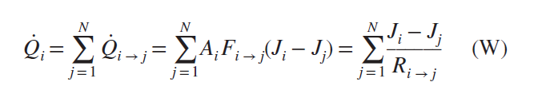
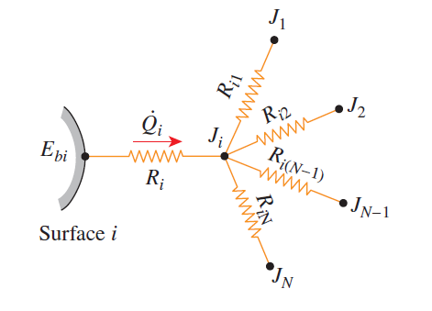

Radiation exchange between surfaces
In an N-surface enclosure, the conservation of energy principle requires that the net heat transfer from surface i be equal to the sum of the net heat transfers from surface i to each of the N surfaces of the enclosure. That is,
which has the electrical analogy interpretation that the net radiation flow from a surface through its surface resistance is equal to the sum of the radiation flows from that surface to all other surfaces through the corresponding space resistances.

Slide 24
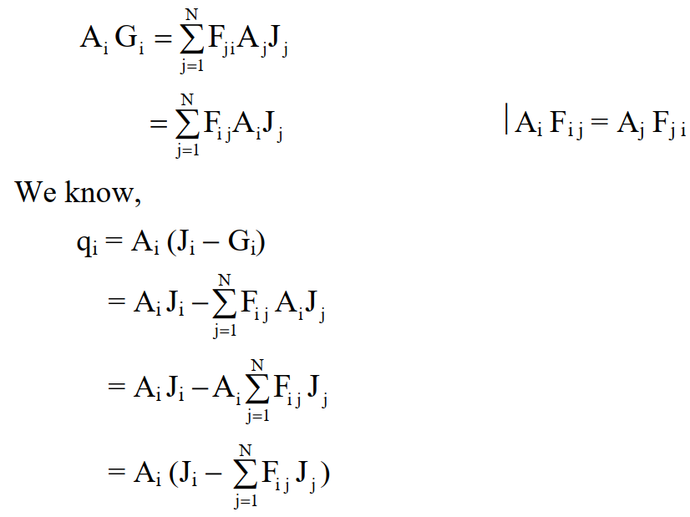
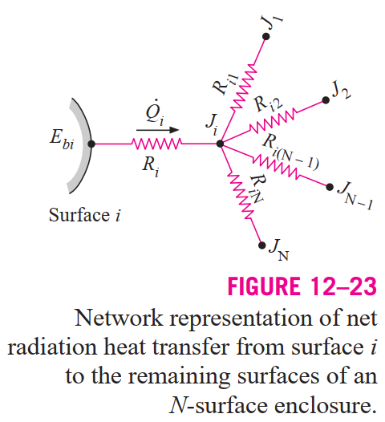
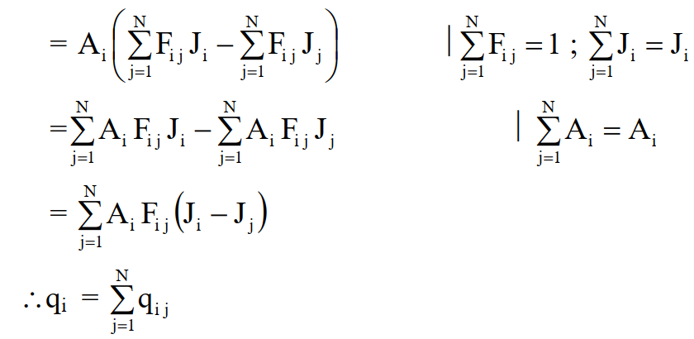
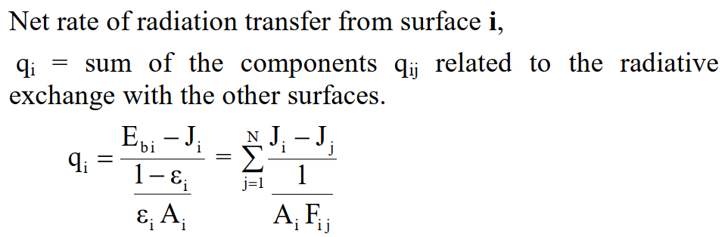
Radiation exchange between surfaces
The total rate at which radiation reaches surface i from all surfaces, including i, is
q_{i}
Q_{i}
Q_{i}
Q_{ij}

Slide 25
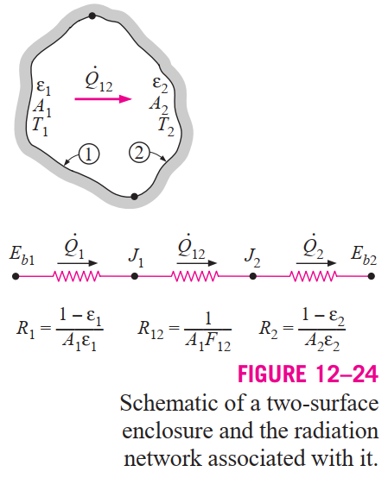

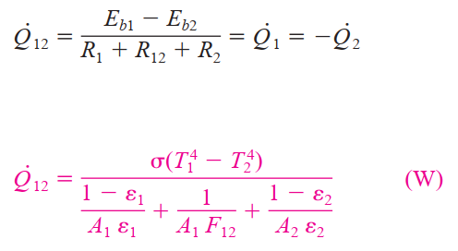
Radiation Heat Transfer in Two-Surface Enclosures
There are only two surfaces in the enclosure, and thus we can write
The radiation network of this two-surface enclosure consists of two surface resistances and one space resistance

Slide 26
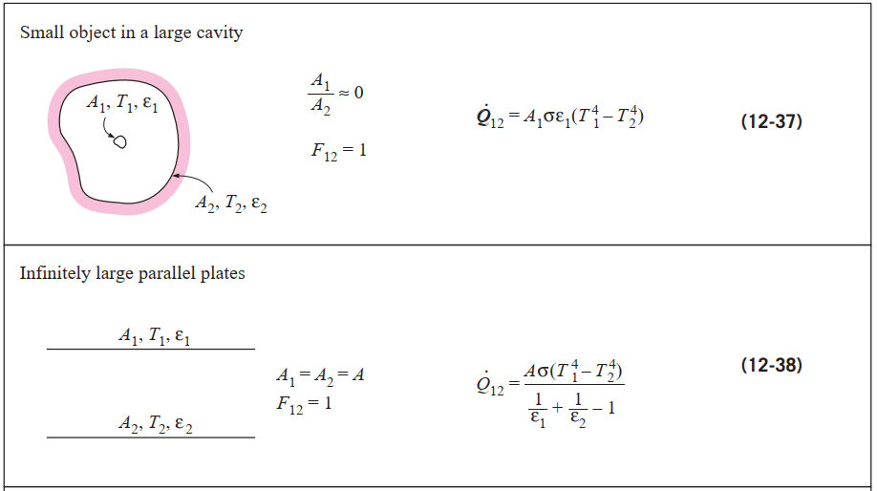

Slide 27
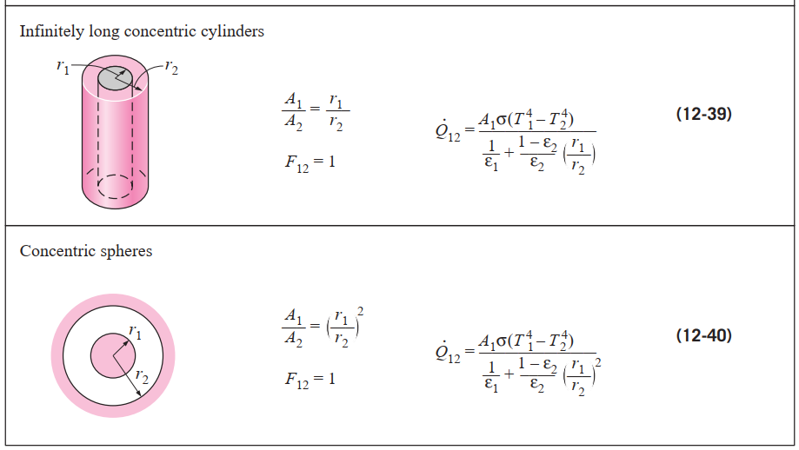

Slide 28
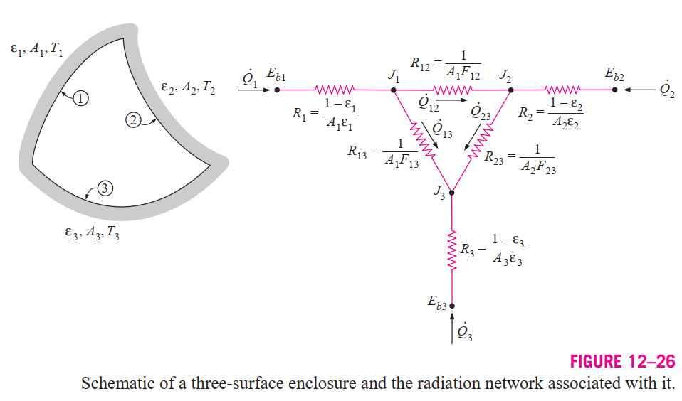
Radiation Heat Transfer in Three-Surface Enclosures
We need to find are the radiosities J1, J2, and J3. The three equations for the determination of these three unknowns are obtained from the requirement that the algebraic sum of the currents (net radiation heat transfer) at each node must equal zero. That is,

Slide 29

Once the radiosities J1, J2, and J3 are available, the net rate of radiation heat transfers at each surface can be determined
The set of equations above simplify further if one or more surfaces are “special” in some way. For example,
for a black or reradiating surface.
for a reradiating surface. W
When the net rate of radiation heat transfer Qi is specified at surface i instead of the temperature, the term should be replaced by the specified Qi.
Some surfaces encountered in numerous practical heat transfer applications are modeled as being adiabatic since their back sides are well insulated and the net heat transfer through them is zero. When the convection effects on the front (heat transfer) side of such a surface is negligible and steady-state conditions are reached, the surface must lose as much radiation energy as it gains, and thus Q_{i} = 0. In such cases, the surface is said to reradiate all the radiation energy it receives, and such a surface is called a reradiating surface.

Slide 30

Radiation Shields and The Radiation Effect
Radiation heat transfer between two surfaces can be reduced greatly by inserting a thin, high-reflectivity (low-emissivity) sheet of material between the two surfaces.
Such highly reflective thin plates or shells are called radiation shields.
The role of the radiation shield is to reduce the rate of radiation heat transfer by placing additional resistances in the path of radiation heat flow.
The lower the emissivity of the shield, the higher the resistance
Multilayer radiation shields constructed of about 20 sheets per cm thickness separated by evacuated space are commonly used in cryogenic and space applications.
Radiation shields are also used in temperature measurements of fluids to reduce the error caused by the radiation effect when the temperature sensor is exposed to surfaces that are much hotter or colder than the fluid itself.

Slide 31



Now consider a radiation shield placed between these two plates
Note that the emissivity of different surfaces of the shield may be different. The resistances are connected in series, and thus the rate of radiation heat transfer is
Noting that F13 = F23 = 1 and A1 = A2 = A3 = A for infinite parallel plates, Eq. 12–42 simplifies to
Additional resistance to radiation introduced by the shield

Slide 32


The appearance of the equation above suggests that parallel plates involving multiple radiation shields can be handled by adding a group of terms like those in the second set of parentheses to the denominator for each radiation shield. Then the radiation heat transfer through large parallel plates separated by N radiation shields becomes
Therefore, when all emissivities are equal, 1 shield reduces the rate of radiation heat transfer to one-half, 9 shields reduce it to one-tenth, and 19 shields reduce it to one-twentieth (or 5 percent) of what it was when there were no shields.

Slide 33




Slide 34




Slide 35



